Slide 1
ASP.NET Continued

Slide 2
Agenda
Routing
HTTPClient
Minimal API
Swagger / Open API

Slide 3
Routing
When building APIs use attribute routing.
Setup with app.MapControllers()
This maps controllers and routes with default settings
E.g. for WeatherForecastController -> {controller=WeatherForecast}/{action=Index}/{id?}
Customize routing with [Route]
On Controller e.g. [Route("api/[controller]")]
Or [Route("api/weather")]
On Endpoints
[HttpPost("delete")]
Or [Route("delete")]
These will be appended on the route

Slide 4
Parameters
We have already seen some
[HttpGet("{name}", Name = "GetWeatherForecast")]
public ActionResult<WeatherForecast> GetSingle(string name) {
The above one will add name to URL
Could also be added as URL paramter (without {name})
[HttpGet("withName", Name = "GetWeatherForecast")]
public ActionResult<WeatherForecast> GetSingle(string name) {
This is called with ?name=yourGivenName

Slide 5

Exercises
Start working on 1-3
Then continue on the Bonus exercise

Slide 6
HTTPClient
This class is used to access an HTTP endpoint from an application.
Can be create with or without BaseAdddress
private HttpClient httpClient = new HttpClient();
Or
private HttpClient httpClient2 = new HttpClient() {
BaseAddress = new Uri("https://jsonplaceholder.typicode.com")
};

Slide 7
What is HTTPClient
General purpose class for accessing HTTP endpoints
Handles Json automatically, but also methods for
Byte[], Stream, String
Note: Json methods are all extensions methods
Methods for all HTTP verbs (GET, POST, PUT, PATCH, DELETE)

Slide 8
HTTP VerbS
GET
await httpClient.GetStringAsync( "https://jsonplaceholder.typicode.com/posts");
await httpClient2.GetStringAsync("posts");
POST
stringContent jsonContent = new(JsonSerializer.Serialize( new { userId = 77, id = 1, title = "write code sample", completed = false } ), Encoding.UTF8, "application/json") await httpClient2.PostAsync("todos", jsonContent)
PUT
await httpClient2.PutAsync("todos/1", jsonContent)

Slide 9
Working WITH JSON
All these methods are from the extension method namespace
using System.Net.Http.Json
Reading
await httpClient2.GetFromJsonAsync<List<Todo>>("todos")
Writing
await httpClient2.PostAsJsonAsync("todos", new {UserId: 9, Id: 99, Title: "Show extensions", Completed: false});

Slide 10
Demo time
TODO

Slide 11
Exercises
Continue on 4-7
Then continue on the Bonus exercise

Slide 12
Minimal API
ASP.NET WebAPI is a framework with lots and lots of features
Security, routing, middlewhere, etc etc etc.
SW4BED – for all the details on database and server applications
Sometimes you need something a little simpler
Minimal ASP.NET WebAPI is .NETs solution to this

Slide 13
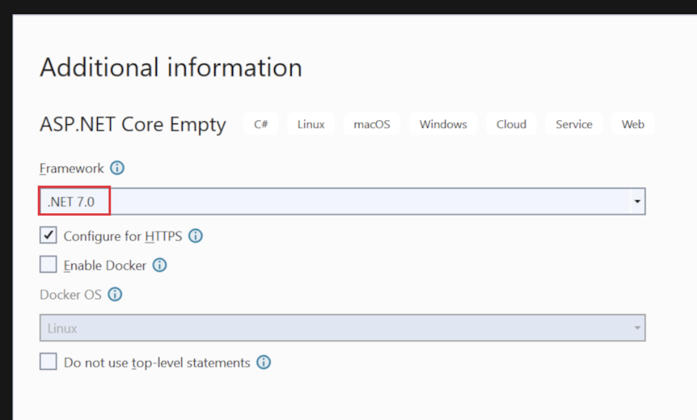
Creating the project
Create a project as normal but uncheck ‘Do not use top-level statements’.
This should create a project with only a Program.cs file.

Slide 14
Hello World
var builder = WebApplication.CreateBuilder(args);
var app = builder.Build();
app.MapGet("/", () => "Hello World!");
app.Run();

Slide 15
Adding an database here
For an InMemory database (one that don’t persists across restarts)
Add NuGET package ‘Microsoft.EntityFrameworkCore.InMemory’
Create a Context file (way to communicate with database)
Add this to your builder in Program.cs builder.Services.AddDbContext<Db>(opt => opt.UseInMemoryDatabase("Data")); builder.Services.AddDatabaseDeveloperPageExceptionFilter();
Use data in your endpoints app.MapGet("/items", async (Db db) => await db.Todos.ToListAsync());

Slide 16
Context file
// DB.cs
using Microsoft.EntityFrameworkCore;
class Db : DbContext
{
public TodoDb(DbContextOptions<Db> options)
: base(options) { }
public DbSet<Data> Data => Set<Data>();
}

Slide 17
HTTP Verbs in minimal
GET app.MapGet(…)
POST app.MapPost(…)
PUT app.MapPut(…)
DELETE app.MapDelete(…)
Note routes needs to be unique

Slide 18
SWAGGEr / Open API
Swagger can also be added in a Minimal API if (app.Environment.IsDevelopment()) { app.UseSwagger(); app.UseSwaggerUI(); }

Slide 19
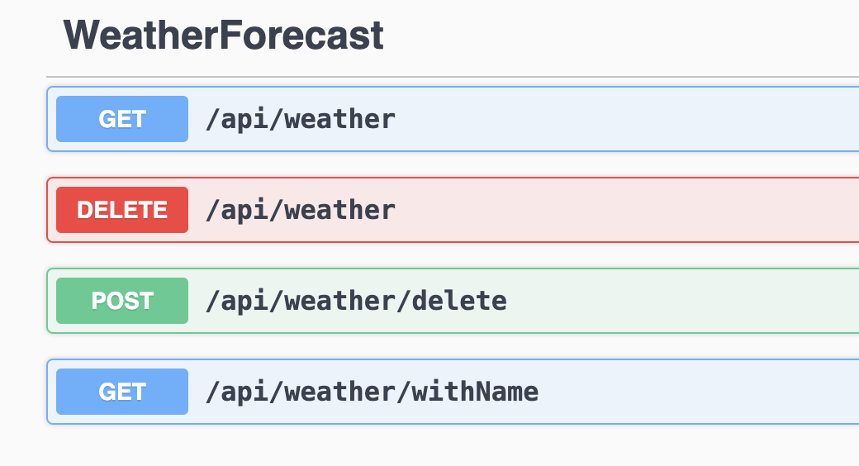
SWAGGER UI
Builds on top of Open API
Specification off an HTTP Web API.
All open endpoints
Described in a Json fil
http://localhost:5207/swagger/v1/swagger.json
Contains endpoints, input, output, and return codes

Slide 20
Exercises
Continue on 8-
Then continue on the Bonus exercise

